Slide 1

Precision parts. Protected margin. Stronger network.
A premium engineering interpretation of the UMI customer review.
Target
Capture
€3.05m
54.2%
FY2027 extended
GPS
ISZE / UMI Sales Review Prototype
source: UMI Sales Review FY2027
Notes:
[Sources]
- Source deck: ISZE_UMI_Sales_Review_FY2027_ModeA_only.pptx. UMI review title and meeting context: lines 23-25.
- FY2027 YTD and budget/LY figures: lines 55-65.
- Commercial parts performance: lines 70-80.
- Category movers: lines 85-150.
- GPS, service-parts coverage, IDS and fleet/target data: lines 176-235 and 240-276.
- SPA and Sales-to-Dealer ask: lines 286-345.

Slide 2
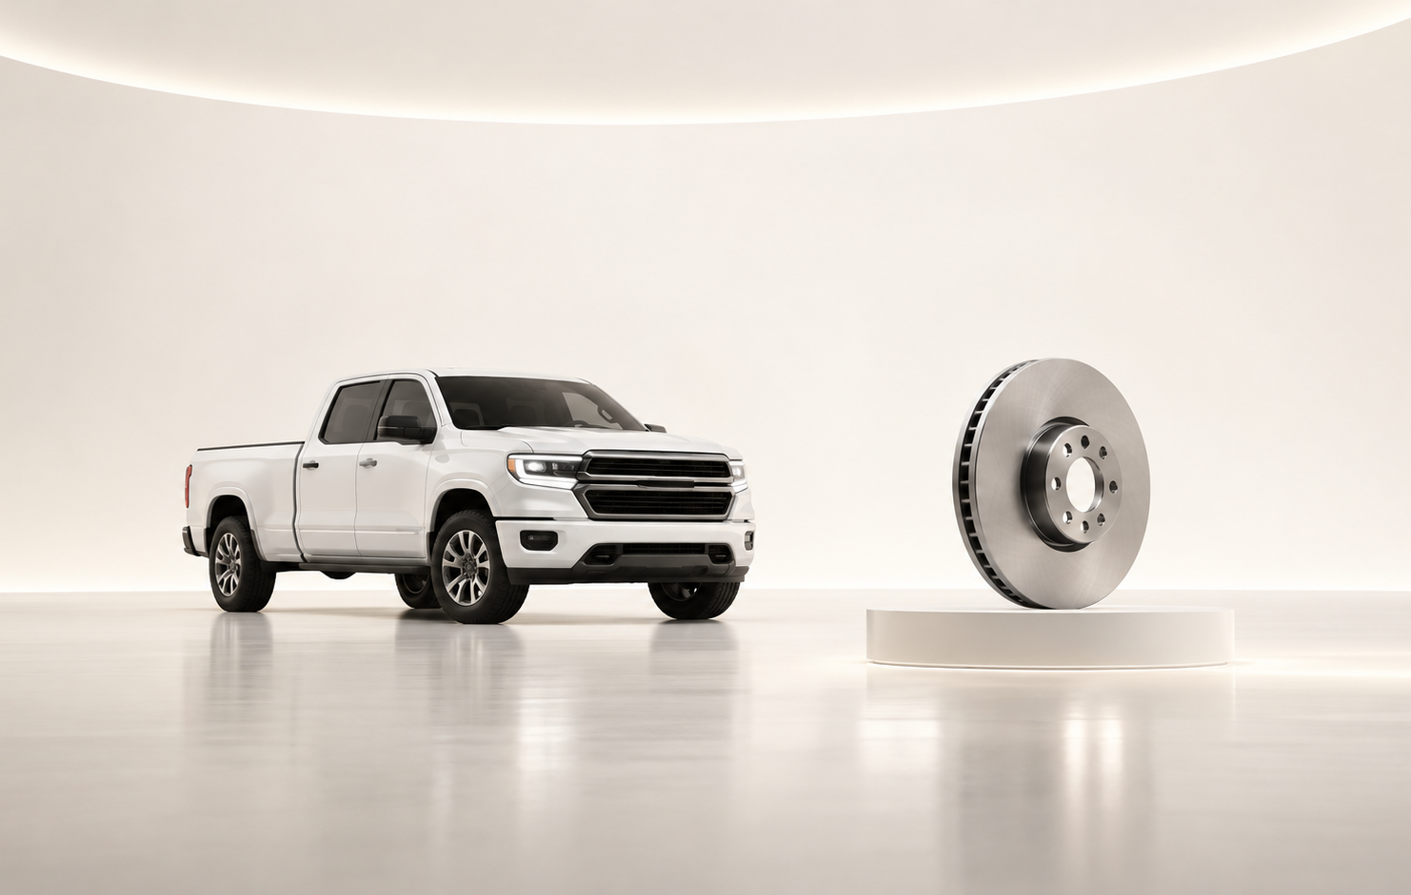
The value case is engineered from specific components
Do not discuss “parts” generically; show the exact systems where the network is losing repeat service.
Brake rotor
Air filter
12.0%
22.9%
vs 60.4% network
vs 56.3% network
ISZE / UMI Sales Review Prototype
source: UMI Sales Review FY2027
Notes:
[Sources]
- Source deck: ISZE_UMI_Sales_Review_FY2027_ModeA_only.pptx. UMI review title and meeting context: lines 23-25.
- FY2027 YTD and budget/LY figures: lines 55-65.
- Commercial parts performance: lines 70-80.
- Category movers: lines 85-150.
- GPS, service-parts coverage, IDS and fleet/target data: lines 176-235 and 240-276.
- SPA and Sales-to-Dealer ask: lines 286-345.

Slide 3
A smaller fleet makes quality of capture more important
Target logic: fleet decline, price move, and controlled stretch.
ISZE / UMI Sales Review Prototype
source: UMI Sales Review FY2027
Notes:
[Sources]
- Source deck: ISZE_UMI_Sales_Review_FY2027_ModeA_only.pptx. UMI review title and meeting context: lines 23-25.
- FY2027 YTD and budget/LY figures: lines 55-65.
- Commercial parts performance: lines 70-80.
- Category movers: lines 85-150.
- GPS, service-parts coverage, IDS and fleet/target data: lines 176-235 and 240-276.
- SPA and Sales-to-Dealer ask: lines 286-345.

Slide 4
Recommended customer promise: disciplined, measurable, premium
Keep the conversation at engineering-quality level: fewer requests, clearer specifications.
Commercial specification
Close Shell price hold
Pick first service-parts pilot
Return SPA counter-list
Share Sales-to-Dealer data
ISZE / UMI Sales Review Prototype
source: UMI Sales Review FY2027
Notes:
[Sources]
- Source deck: ISZE_UMI_Sales_Review_FY2027_ModeA_only.pptx. UMI review title and meeting context: lines 23-25.
- FY2027 YTD and budget/LY figures: lines 55-65.
- Commercial parts performance: lines 70-80.
- Category movers: lines 85-150.
- GPS, service-parts coverage, IDS and fleet/target data: lines 176-235 and 240-276.
- SPA and Sales-to-Dealer ask: lines 286-345.

